Slide 1
MATC’s Hispanic-Serving Institution (HSI) Initiative Report and Recommendations
Dr. Wilma L. Bonaparte, Mequon Campus-Executive Director and Co-Chair of the HSI Taskforce Initiative
Dr. Arturo Martinez, Walker’s Square-Director and Co-Chair of the HIS Taskforce Initiative
August 4, 2020

Slide 2
HSI Taskforce Members
Arturo Martinez martinas@matc.edu Marwill Santiago santiam@matc.edu Giovanna Doll, Giovanna dollg@matc.edu Carlos Aranda arandac@matc.edu Marisela Galaviz galavizm@matc.edu Patricia Gomez gomezc@matc.edu Erika Reyes reyese@matc.edu Anne-Marie Bernard bernarda@matc.edu Nora Alvarado alvaranv@matc.edu Rosy Lopez lopezr81@matc.edu Jose Ortega ortegaji@matc.edu David Espinoza espinozd@matc.edu Annette Velez veleza@matc.edu Alvarez Esmeralda alvare26@matc.edu Lorena Bonilla bonillal@matc.edu Bertha Gonzalez gonzab35@gmatc.matc.edu Amarilis Martinez martia7@matc.edu Cynthia Galvan galvanc@matc.edu Suzann Gardner gardnesc@matc.edu

Slide 3
What I asked from the task force members (February 2019)
Identify Task force members
Consistent and clear message across campus of the benefits
Promotion of cultural competence and actions of cultural humility

Slide 4
2018-19 Guided Pathways HSI Task Force Team Charter
PILLAR & ESSENTIAL PRACTICE
Entering & Staying: Hispanic Serving Institute Task Force
PROJECT DESCRIPTION:
Under the leadership of Dr. Wilma Bonaparte, this team will oversee a multi-faceted plan that will increase our Hispanic population enrollment from 16.4% to 25% and retention rates from 55% to 70% by 2025. Using S.M.A.R.T. objectives, the Team will develop and follow a series of 90-Day Plans that complement the work of the Guided Pathways Steering Committee and Teams.

Slide 5
Video Update on HSI Initiative

Slide 6
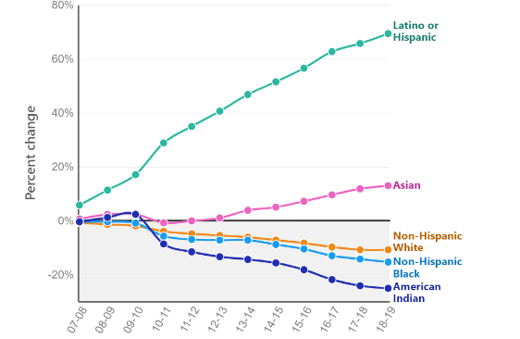
The Growing Latinx Community in Wisconsin
Change in Wisconsin public school enrollment by race/ethnicity
https://www.wiscontext.org/why-more-wisconsin-schools-are-enrolling-fewer-students
Notes:
The state as a whole is seeing similar changes. This chart, which was created by researchers at the University of Wisconsin Applied Population Laboratory, shows the percent change in statewide public school enrollment by race/ethnicity since the 2006-07 school year. The number of non-Hispanic white students has declined by 12%, and Non-Hispanic black and American Indian students have also declined in this same time period (by 15% and 25%, respectively.) On the other hand, the number of Asian students has risen by 13%, while the number of Hispanic students has increased by 69%. https://www.wiscontext.org/why-more-wisconsin-schools-are-enrolling-fewer-students
The trend is no different in our private schools. The Catholic Archdiocese of Milwaukee, for example, which serves 30,000 students across 10 southeastern counties of Wisconsin, is now more than a quarter Latinx. (Personal communication with Superintendent of Catholic Schools, 2017)
If you look at FUTURE projections, the number of college-aged Latinxs across the state will continue to grow. (WICHE)

Slide 7
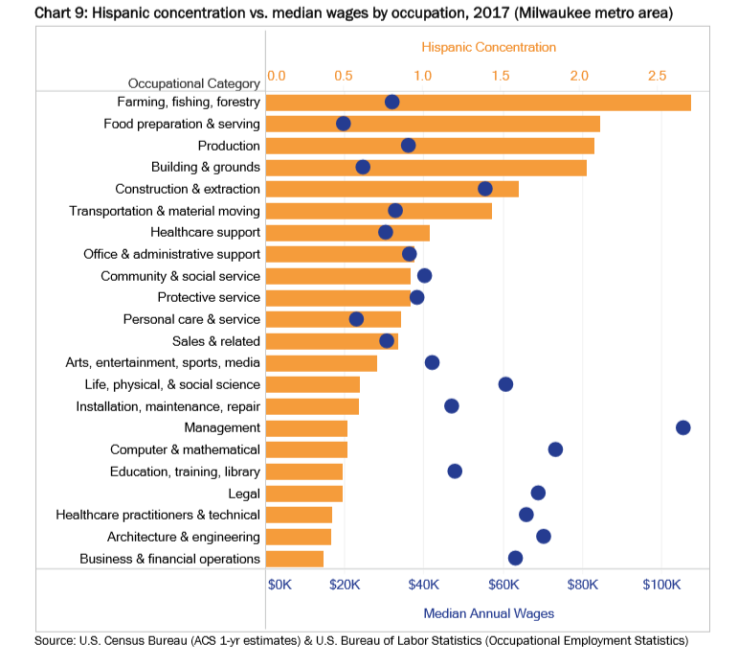
Economic Opportunities
https://wispolicyforum.org/wp-content/uploads/2019/05/UpwardMobility_FullReport.pdf
Notes:
We also know that often higher-paying jobs require education beyond a high school degree. I show this chart, again from the Wisconsin Policy Forum report, as an example of how a lack of educational opportunities can be correlated with a lack of economic opportunities.
In our region, Latinxs – who have lower educational attainment - are extremely underrepresented in a number of relatively high-paying professional occupations. For example, Hispanics in the greater MKE area are severely underrepresented in sectors such as business and finance, healthcare, education, computer tech, and law. In fact, Hispanics are highly underrepresented in every category that pays a median annual wage of $60,000 or higher. (Orange bars show hispanic concentration in different fields compared to non-Hispanics, so under 1.0 would be underrepresented).

Slide 8
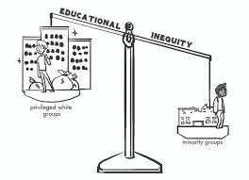
But…
Hispanics in our region’s are among the most educationally underserved.
This population is the least likely to have a high school diploma, and Hispanic/Hispanic adults in the four-county Milwaukee metro area are about one-third as likely as their white counterparts to have a four-year degree.

Slide 9
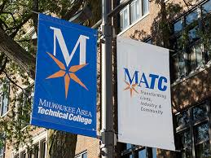
MATC is positioned
Bilingual course offerings and programs
The MATC Promise program offers free tuition to eligible students, making college possible for students otherwise may have not perceived it to be a possibility.
Guided Pathways
Only IHE with an existing MOU with the Mexican Consulate of Wisconsin
Only two-year institution in WTCS with a partnership with HPGM that grants scholarships for eligible DACA students
Co-collaboration with other SE Wisconsin IHE’s including 2020 Diversity Summit and HACU presentation
(retrieved 11/24/18 from https://www.matc.edu/).

Slide 10
Trending Upward (MATC Hispanic undergradautes according to HACU)
Fall 2017
16.4%
Fall 2018
17.3%
Fall 2019
18.9%

Slide 11
Student Voices
Marketing materials/social media that reflects their culture
Signs, videos, websites, and other materials in Spanish
Campus space dedicated to showcase their culture
Programs and classes in Spanish or bilingually
Mentors with whom they can identify
Apprentices/internships, clinical placements, and service learning opportunities in their communities

Slide 12
Student Voices
Adequate financial aid packages available and information about financial assistance communicated early and often.
Hispanic students expect faculty who are supportive and, to the fullest extent possible, to see professors who can understand the background from which they come.
Intentional recruitment of Hispanic faculty and staff
Commitment among non-Hispanic faculty to be empathetic and understanding and to have a sense of cultural humility that lends itself to inclusive practices in their classroom pedagogy.
The ability to hear Spanish being spoken on campus, between students, and between faculty/staff and students, in a way that is accepted and honored as an asset, not a deficit.
Cultural programs, groups and events that demonstrate that the college embraces their culture in authentic ways.

Slide 13
Recommendation #1: Create an Office of Hispanic Initiatives (OHI) (reporting to the MATC President) (and DREAM Center, see Recommendation #4)
Lead the strategic efforts and collaborate with units across the college:
Retention
Scholarship
Recruitment & enrollment initiatives
Articulation

Slide 14
Bilingual curriculum
Pedagogy
Professional development in cultural competency
Hiring
Grants
HACU membership
Community relationships

Slide 15
Recommendation #2: Centralize and Strengthen Bilingual and ELL Services and Programs
Centralized services and offering a comprehensive set of best practice strategies in ELL and bilingual pedagogy to design and deliver a clear, sustainable pathway that prepares Spanish speaking students for careers including the vocational trades, STEM fields, teacher education preparation programs such as Early Childhood, and Liberal Arts and Sciences:
Bilingual GED and Basic Skills
Bilingual Summer Bridge program
Intensive English Institute for second language learners
English college-level courses at MATC (VESL)
Bilingual ELL reading and writing center

Slide 16
Recommendation #3: Shift Hiring Practices
Hire more diverse, bilingual, and culturally competent faculty and staff across departments:
Create hiring language and protocols that encourage greater diversity and bilingualism in applicant pools
Trainings for hiring committees on mitigating the impact of implicit bias in the hiring process
Intentional advertisement of positions
Compensate bilingualism

Slide 17
Add positions in areas such as the following to assist with the growing needs of serving a diverse student population:
Center for Teaching and Learning, to assist in faculty training and development in cultural responsiveness
Bilingual Education, to further develop and standardize Bilingual Curriculum and programs,
Pre-College, to further develop High School Dual Enrollment agreements
Enrollment, to assist specifically with Hispanic student outreach, retention and recruitment efforts
Financial Aid

Slide 18
Recommendation #4: Respond to the Needs of MATC’s Undocumented/DACAmented Students
Create a position and/or identify an office within the Office of Hispanic Initiative Office that serves as the central hub for information and support for undocumented/DACAmented students.
College leadership should make public statements around MATC’s position on undocumented students.

